Slide 1

CALENDAR

Slide 2
ODD DAYS: In a given period, the number of days more than the complete weeks are called odd days.
To obtain divide by 7 and remainder is odd days.
Type of year:
1. Normal or ordinary year(NOT DIVISIBLE BY 4):
Total: 365 days=52 week and 1 odd day
2. Leap year(DIVISIBLE BY 4, & BY 400 IN CASE OF CENTURY):
Total : 366 days(29TH February extra)=52 week and 2 odd day

Slide 3
Odd in a century:
100 years = 76 ordinary years + 24 leap years.
Ordinary year = 1 odd day, Leap year = 2 odd days
=76(1)+24(2)= 76+48=124
=124/7=17 week and 5 odd days
100 year= 5 odd day.
Years | No. of odd
Ordinary year | 1
Leap year | 2
100 years | 5
200 years | 3
300 years | 1
400 years | 0

Slide 4
IMPORTATNT NOTE:
The years which are divisible by 400 have 0 odd, e.g. 400, 800, 1200, 1600, 2000, etc.
Last day of a century cannot be Tuesday, Thursday or Saturday.
April & July for all years and January and October for non-leap years have the same calendar.

Slide 5
BASIC METHOD TO FIND DAY ON A PARTICULAR DATE AND YEAR
For ex: day on 15th august 1947 ?
15 Aug, 1947 = (1946 years + Period from 1.1.1947 to 15.8.1947)
Odd days in 1600 years = 0
Odd days in 300 years = 1
46 years = (35 ordinary years + 11 leap years) = (35 x 1 + 11 x 2)= 57 (8 weeks + 1 day) = 1 odd day

Slide 6
Jan. Feb. Mar. Apr. May. Jun. Jul. Aug
( 31 + 28 + 31 + 30 + 31 + 30 + 31 + 15 ) = 227 days = (32 weeks + 3 days) = 3 odd days.
Total number of odd days = (0 + 1 + 1 + 3) = 5 odd days.
Hence, as the number of odd days = 5 , given day is Friday.

Slide 7
SHORTCUT TO FIND DAY ON A PARTICULAR DATE AND YEAR
Year Code
Month Code
Day Code
Year Code:-
1600-1699 | 6
1700-1799 | 4
1800-1899 | 2
1900-1999 | 0
2000-2099 | 6

Slide 8
Month Code:-
Jan | Feb | Mar | April | May | June | July | Aug | Sep | Oct | Nov | Dec
0 | 3 | 3 | 6 | 1 | 4 | 6 | 2 | 5 | 0 | 3 | 5
Day Code:-
Sunday | Monday | Tuesday | Wednesday | Thursday | Friday | Saturday
0 | 1 | 2 | 3 | 4 | 5 | 6

Slide 9
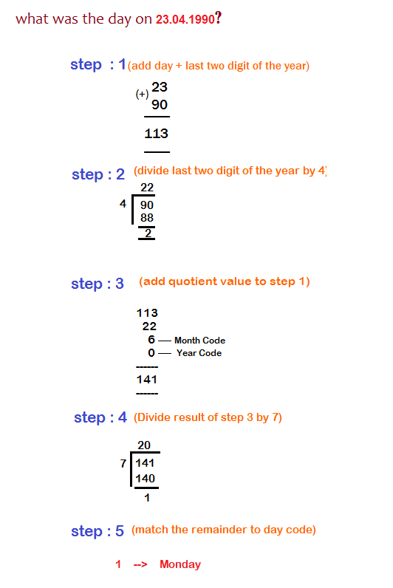

Slide 10
QUESTIONS:
1. Today is Monday. After 61 days, it will be :
A. Tuesday
B. Monday
C. Sunday
D. Saturday
SOL.D
Notes:
1. Each day of the week is repeated after 7 days.
So, after 63 days, it will be Monday.
After 61 days, it will be Saturday.
2. On 31st December, 2005 it was Saturday.
Number of odd days from 2006 to 2009 = (1 + 1 + 2 + 1) = 5 days.
On 31st December 2009, it was Thursday.
Thus, on 1st Jan, 2010 it is Friday

Slide 11
2.It was Sunday on Jan 1, 2006. What was the day of the week Jan 1, 2010?
Monday
B. Friday
C. Sunday
D. Tuesday
SOL.B

Slide 12
3. January 1, 2007 was Monday. What day of the week lies on Jan. 1, 2008?
Sunday
B. Saturday
C. Tuesday
D. Wednesday
SOL.C
Notes:
3. The year 2007 is an ordinary year. So, it has 1 odd day.
day of the year 2007 was Monday
day of the year 2008 will be 1 day beyond Monday
Hence, It will be Tuesday.

Slide 13
4. What was the day on 31st Oct 1984?
(a) Friday
(b) Sunday
(c) Wednesday
(d) Monday
SOL.C
Notes:
4. In 1984, divide 84/4 = 21
Code for Oct = 0 (Refer the above shown calendar for codes)
Mentioned Date= 31
Result = 84+21+0+31 =136
To find the day of week, divide the result by 7 and write the remainder = 136/7 = 3 (remainder)
3 is the code for Wednesday so the answer will be Wednesday.

Slide 14
5. The calendar for the year 2007 will be the same for the year?
2014
2016
2017
2018
SOL. D
Notes:
5. Count the number of odd days from the year 2007 onwards to get the sum equal to 0 odd day
2007-1
2008-2
2009-1
2010-1
2011-1
2012-2
2013-1
2014-1
2015-1
2016-2
2017-1
Sum of odd days: 14 odd days means 0 odd days
Hence same calendar.

Slide 15
6. If 6th March, 2005 is Monday, what was the day of the week on 6th March, 2004?
Sunday
Saturday
Tuesday
Wednesday
SOL.A
Notes:
6. The year 2004 is a leap year. So, it has 2 odd days.
But, Feb 2004 not included because we are calculating from March 2004 to March 2005.
So it has 1 odd day only.
The day on 6th March, 2005 will be 1 day beyond the day on 6th March, 2004.
Given that, 6th March, 2005 is Monday.
6th March, 2004 is Sunday (1 day before to 6th March, 2005).

Slide 16
7.If Aug 15th,2012 falls on Thursday then June 11th,2013 falls on which day ?
Wednesday
Saturday
Monday
Tuesday
SOL.A
Notes:
7. First,we count the number of odd days for the left over days in the given period.
Here,given period is 15.8.2012 to 11.6.2013
Aug Sept Oct Nov Dec Jan Feb Mar Apr May Jun
16 30 31 30 31 31 28 31 30 31 11(left days)
2 + 2 + 3 + 2 + 3 + 3 + 0 + 3 + 2 + 3 + 4 (odd days) = 6 odd days
So,given day Thursday + 6 = Wednesday is the required result.

Slide 17
8. On what dates of April, 2001 did Wednesday fall?
2nd,9th,16th,23rd
4th,11th,18th,25th
12th,18th,27th,6th
1st,8th,15th,22nd
SOL.B.
Notes:
8. We shall find the day on 1st April, 2001.
1st April, 2001 = (2000 years + Period from 1.1.2001 to 1.4.2001)
Odd days in 1600 years = 0
Odd days in 400 years = 0
Jan. Feb. March April
(31 + 28 + 31 + 1) = 91 days 0 odd days.
Total number of odd days = (0 + 0 + 0) = 0
On 1st April, 2001 it was Sunday.
In April, 2001 Wednesday falls on 4th, 11th, 18th and 25th.

Slide 18
9. Find the day of the week on 26th Jan 2012?
A. Tuesday
B. Thursday
C. Friday
D. Sunday
SOL.B
Notes:
9. Here the year is 2012 so follow the second rule and consider the last 3 digit i.e 012. It is less than hundred so add 100 to it. After adding 100, it becomes 112. Now, divide it by 4. You will get 28. Also note that it is a leap year.
Code of Jan = 6 (due to leap year)
Mentioned Date= 26
Result = 112+28+6+26 = 172
To find the day of week, divide the result by 7 and write the remainder = 172/7= 4
4 is the code for Thursday so the answer will be Thursday.

Slide 19
10. How many days are there in x weeks x days?
7x * x
B. 8x
C. 14x
D. 7
SOL. B
Notes:
10. x weeks x days = (7x + x) days = 8x days.

Slide 20
What is leap year?
A leap year is a year in which an extra day is added to the Gregorian calendar, which is used by most of the world.
While an ordinary year has 365 days, a leap year has 366 days.
A leap year comes once every four years. Because of this, a leap year can always be evenly divided by four.

Slide 21
11. How many leap years do 300 years have?
75
74
72
73
SOL. C
Notes:
11. Given year is divided by 4, and the quotient gives the number of leap years.
Here, 300/4 = 75.
But, as 100,200 and 300 are not leap years => 75 - 3= 72 leap years.

Slide 22
The calendars of two different years are same
if they satisfy the following conditions;
The years must be of same type, i.e. both must be either ordinary years or leap years.
b) January 21 of both the years, must be the same day of the week.

Slide 23
12. The calendar of the year 1897 can be used again in the year?
1908
1901
1903
1926
SOL. C
Notes:
12. Given year 1908, when divided by 4 leaves a remainder of 1.
NOTE: When remainder is 1, 6 is added to the given year to get the result.
So, 1908 + 6 = 1903

Slide 24
13. The calendar for the year 2007 will be the same for the year:
A 2014
B 2016
C 2017
D 2018
Answer D
Notes:
Answer:- Count the number of odd days from the year 2007 onwards to get the sum equal to 0 odd day.
Year : 2007 2008 2009 2010 2011 2012 2013 2014 2015 2016 2017
Odd day : 1 2 1 1 1 2 1 1 1 2 1
Sum = 14 odd days 0 odd days.
Calendar for the year 2018 will be the same as for the year 2007.

Slide 25



